Slide 1
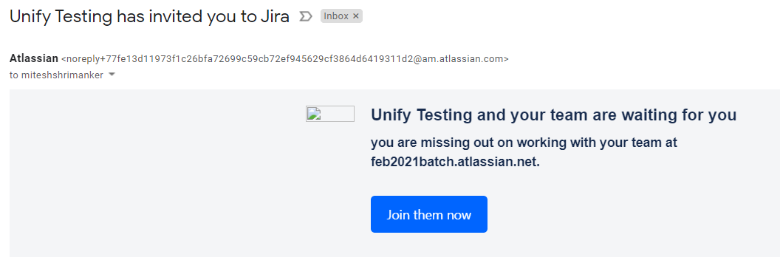


Slide 2
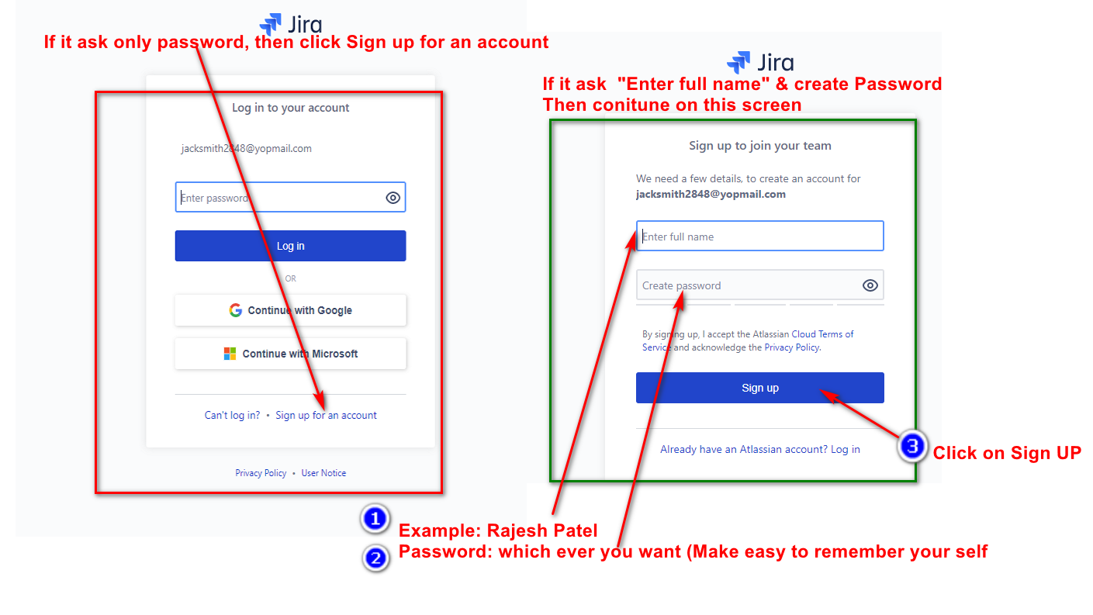

Slide 3
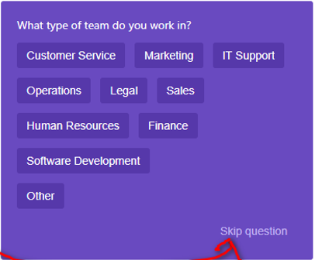
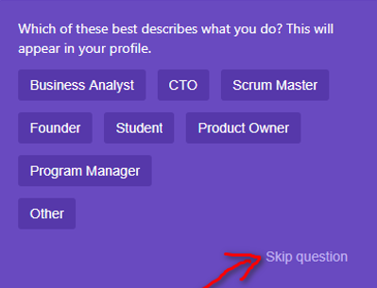


If any screen comes like below just SKIP the question.

Slide 4
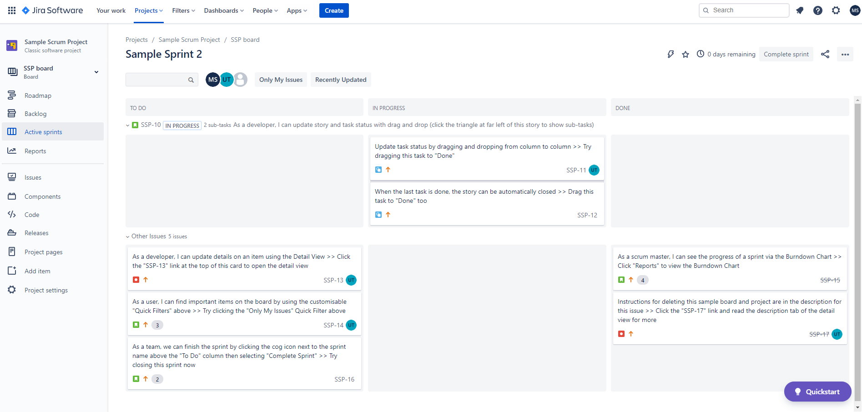

Once you login click on projects (if not on it already)
Create bug by clicking on below link.

Slide 5
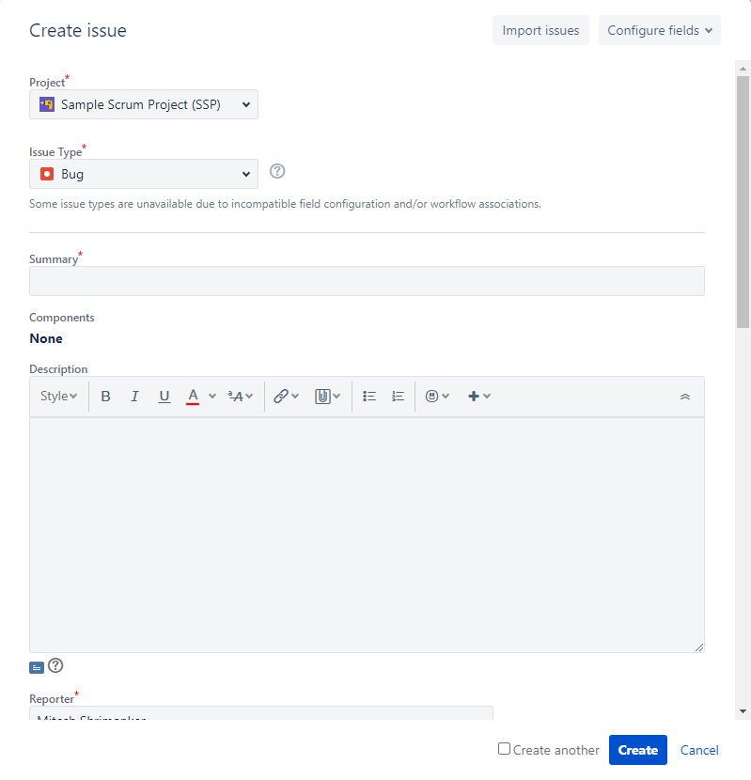
Create bug as shown in class for one of your failed test cases.

